Slide 1
A Comparative Study of Programming Languages in Rosetta Code

Slide 2
Time allocation – hidden
Overview 5
Research Setup 5
Programming paradigms overview 20
Results:
RQ1 – Conciseness 5
RQ2 – Executable Size 5
RQ3 – Running time 5
RQ4 – Memory usage 5
RQ5 – Error proneness 5
Conclusion 5
Haskell 10
Go 5 ……………… TOTAL: 80

Slide 3
Overview

Slide 4
Overview
What is the best programming language?
What is the best programming language for feature/project X ?
What are the advantages of a language over another?

Slide 5
Overview
What might affect my selection of language ?
My languages knowledge
Project/company decisions
Moods and trends
Existence of libraries/tools
Open source community/support
Empirical features

Slide 6
Empirical Features
Conciseness
Maintainability
Performance
Safety
Fit the running environment

Slide 7
Research

Slide 8
Research Questions
RQ1 : Which programming languages make for more concise code ?
RQ2 : Which programming languages compile into smaller executables ?
RQ3 : Which programming languages have better running-time performance ?

Slide 9
Research Questions
RQ4 : Which programming languages use memory more efficiently ?
RQ5 : Which programming languages are less failure-prone?

Slide 10
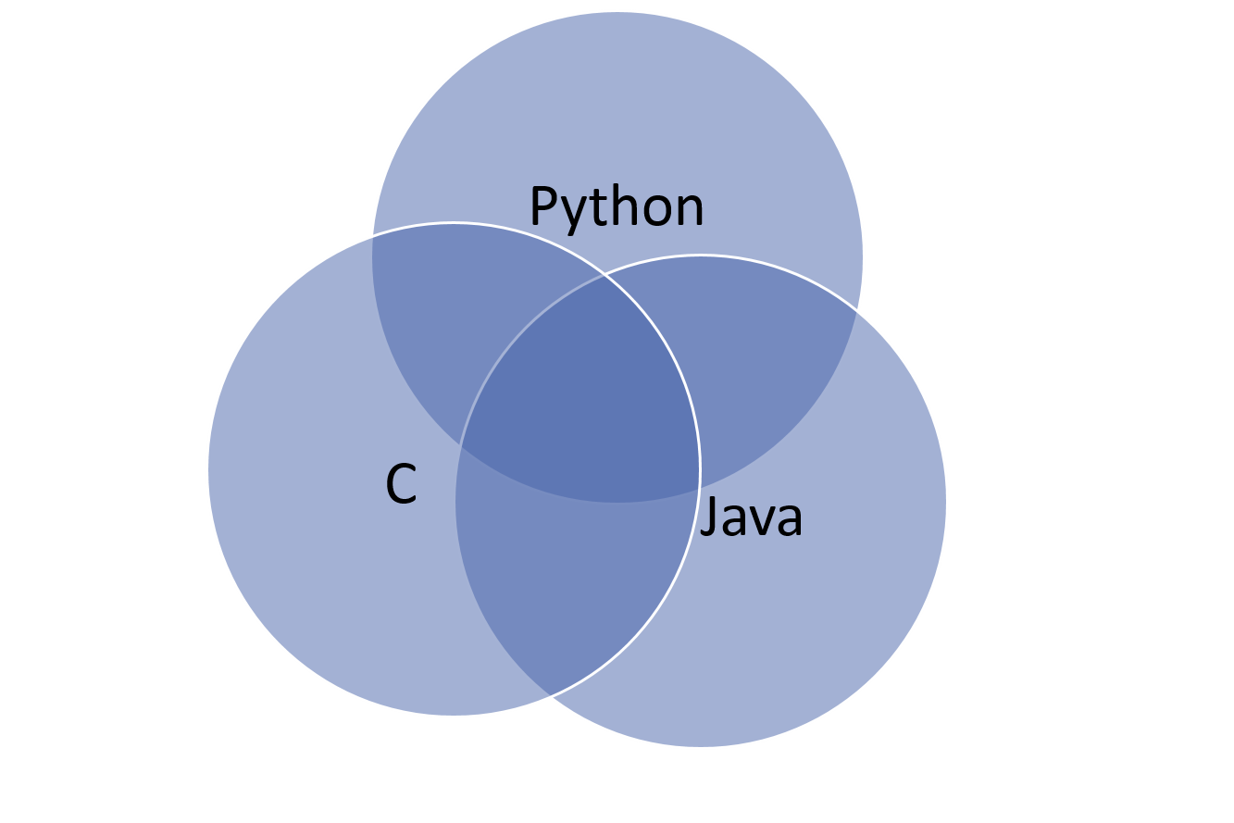
Research Method
Rosetta Code – a code repository
Online, open-source
Purposes
Tasks, Languages, Solutions
745 tasks, 379 languages

Slide 11
Research Method
Task examples
Algorithmic: Bubble sort, Mat-mult
I/O: GUI application, HTTP request, File I/O
Text: Parsing (XML), Strings
Data structures: List traversal, Trees etc.

Slide 12
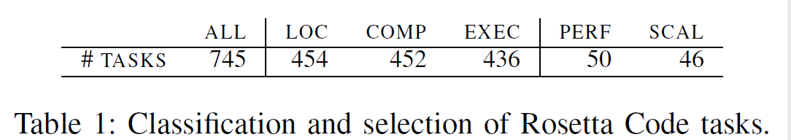
Research Method – Task selection
745 tasks.
Select clearly-defined tasks.
Minor variants of a unique problem.

Slide 13
Research Method – Language selection
Select from 379 languages (!):
Prefer popular languages (TIOBE rating).
Ensure enough data for statistical analysis (common in Rosetta).
Mitigate “Hyped” languages.

Slide 14
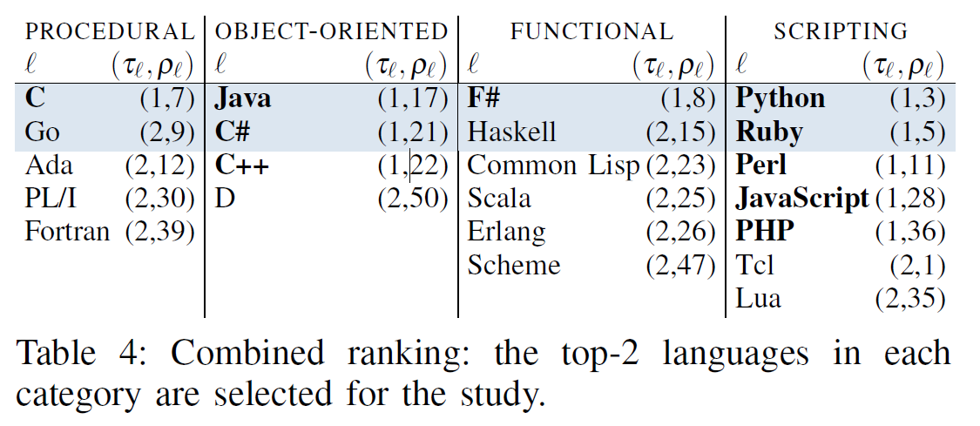
Overview
8 languages that were compared.
Divided into 4 groups based on their Programming Paradigm/“type”.

Slide 15
Overview
Difference than other researches

Slide 16
Programming Paradigms

Slide 17
Definition
A Programming Paradigm is “A fundamental style of programming, serving as a way of building the structure and elements of computer programs.”¹
Languages have capabilities and styles, based on their supported paradigms. i.e. Java follows object-oriented paradigm.
Some languages follow a single paradigm, while others are multi-paradigm.

Slide 18
Languages by paradigms
Languages in study:
Procedural : C, Go
Object Oriented: Java, C#
Functional: Haskell, F#
Scripting (*): Python, Ruby

Slide 19
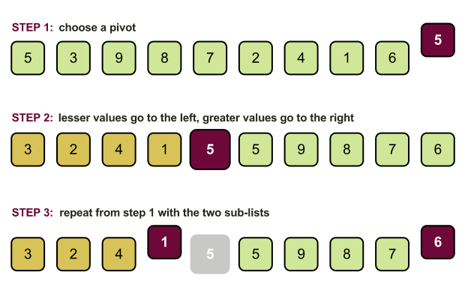
Programming Paradigms
Let’s demonstrate the PP’s by a known algorithm:
Quicksort:

Slide 20

Procedural Paradigm
Procedural programming is based upon the concept of procedure calls.
Each procedure = a set of computational steps to carry out.
Sequential.
Examples: C, Go, C++

Slide 21
Procedural Paradigm
Programming with side effects.
Top-down approach:
one “main” procedure
has 5-6 sub routines, each built once again on 5-6 subroutines.
And so on
Other approaches (recursive).

Slide 22
Procedural Paradigm
int main () { int a[] = {4, 65, 2, -31, 0, 99, 2, 83, 782, 1}; int n = sizeof a / sizeof a[0]; int i; for (i = 0; i < n; i++) printf("%d%s", a[i], i == n - 1 ? "\n" : " "); quick_sort(a, n); for (i = 0; i < n; i++) printf("%d%s", a[i], i == n - 1 ? "\n" : " "); return 0; }

Slide 23
Procedural Paradigm
void quick_sort (int *a, int n) { int i, j, p, t; if (n < 2) return; p = a[n / 2]; for (i = 0, j = n - 1;; i++, j--) { while (a[i] < p) i++; while (p < a[j]) j--; if (i >= j) break; t = a[i]; a[i] = a[j]; a[j] = t; } quick_sort(a, i); quick_sort(a + i, n - i); }

Slide 24
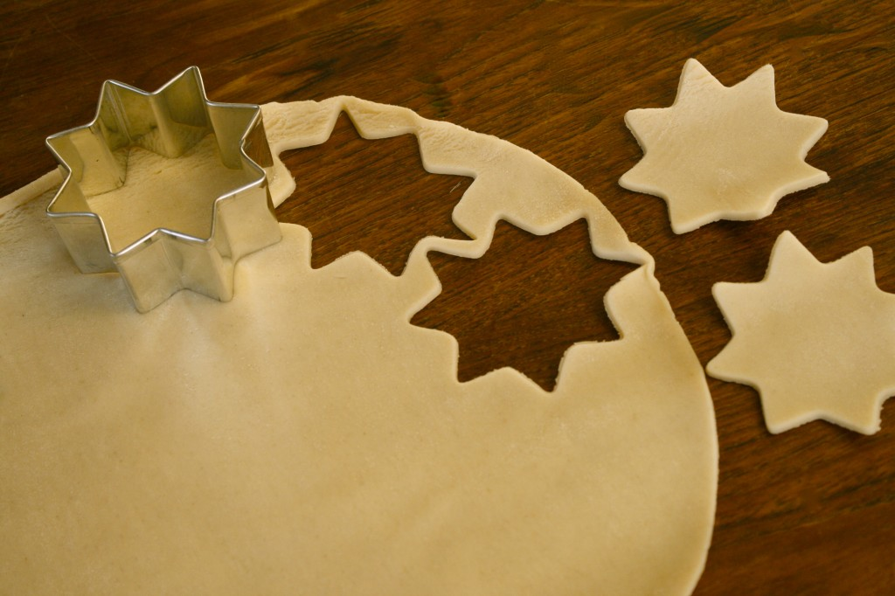
Object oriented paradigm
Based on concept of “Objects”.
Data = “fields”
Code = “methods”
Objects are instances of class (prototype).
Objects access their own data/code.
Interaction with other objects.

Slide 25
Object oriented paradigm
Encapsulation
“Resource Acquisition Is Initialization (RAII)”
Inheritance
Polymorphism
Example languages: Java, C#, C++, Python

Slide 26
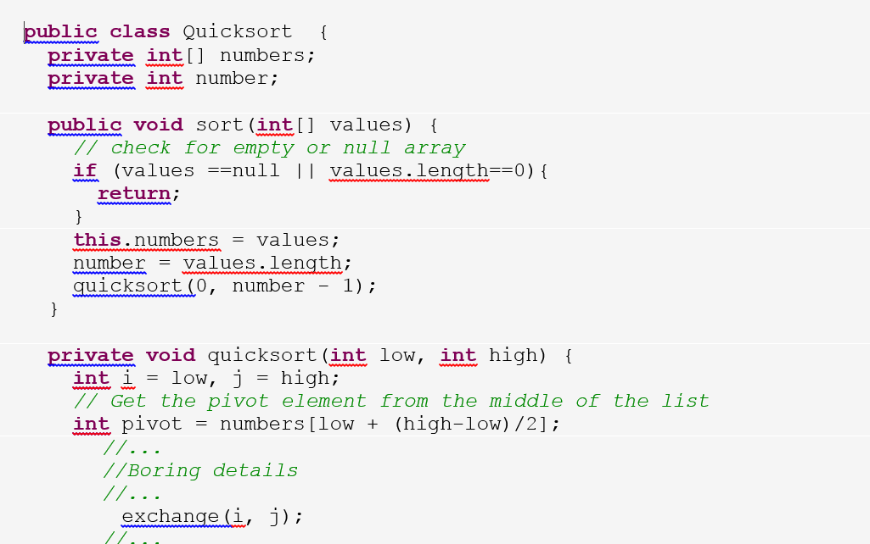
Object oriented paradigm

Slide 27
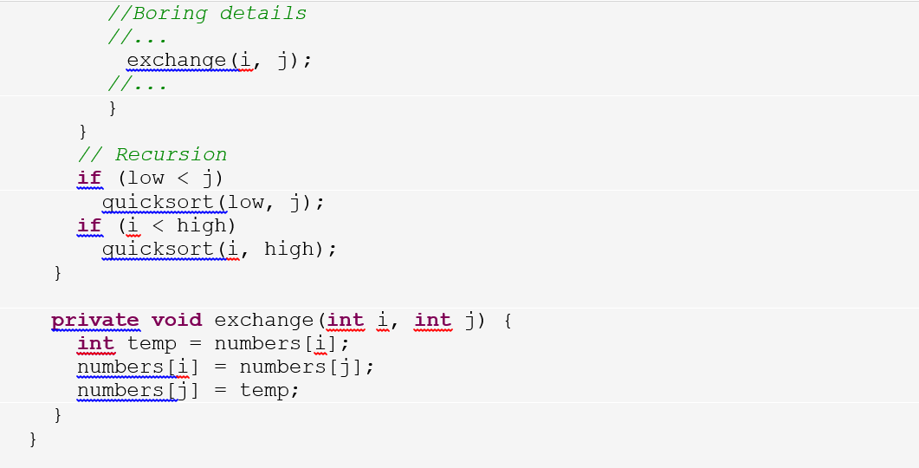
Object oriented paradigm

Slide 28
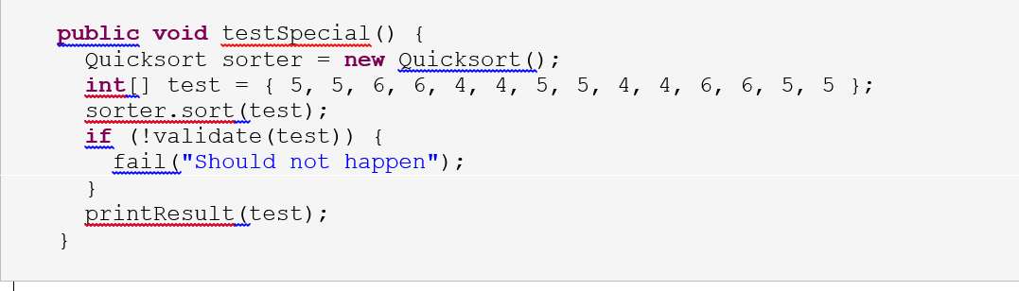
Object oriented paradigm

Slide 29
Functional Paradigm
Derived from the word function.
Everything is evaluated.
Example languages: LISP/Scheme, Haskell, ML, Python ...

Slide 30
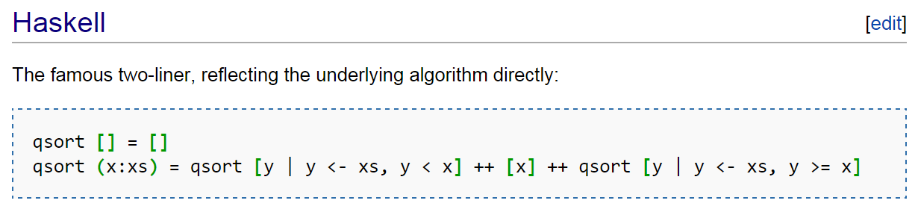
Functional Paradigm

Slide 31
Results
כולן יפות, כולן חכמות, אבל רק אחת זוכה

Slide 32
Conciseness
RQ1 : Which programming language make for more concise code ?

Slide 33

Results format
Gambling:
Which paradigms are better/worse?
Big Winner? (specific language)
Big Loser?
Ratio

Slide 34
Conciseness
RQ1 : Which programming language make for more concise code ?
Non-comment, non-blank lines of code
Not required to run correctly, or even compile
Shortest solution for each task in a language

Slide 35
Why it is important?
Bug density is constant across programming languages.
(Meaning – shorter means less bugs.)¹
Readability
Ability for code to be maintained, fixed, enhanced, tested etc.
By peers or by original writer

Slide 36
Example – File I/O
Read file into buffer (in chunks), output to another file.

Slide 37
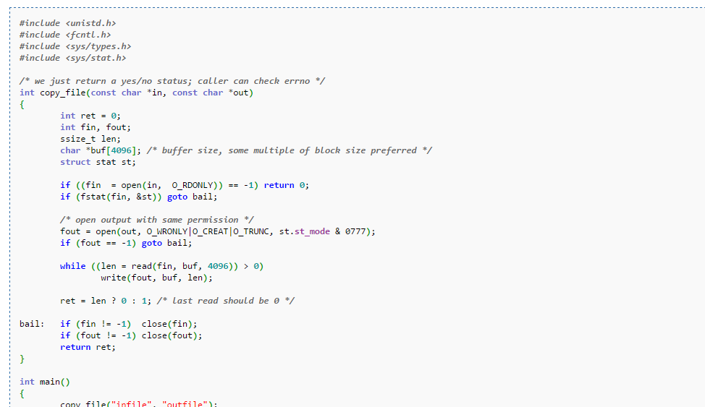
C

Slide 38
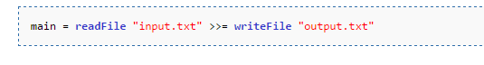
Haskell

Slide 39
What might improve conciseness?
Simplified, expressive syntax
Objects, abstractions
Less checks on variable’s state
Use of external libraries
String interfaces
Collection interfaces

Slide 40
Any guess ?
Gambling:
Which paradigms are better/worse?
Big Winner? (specific language)
Big Loser?
Ratio

Slide 41
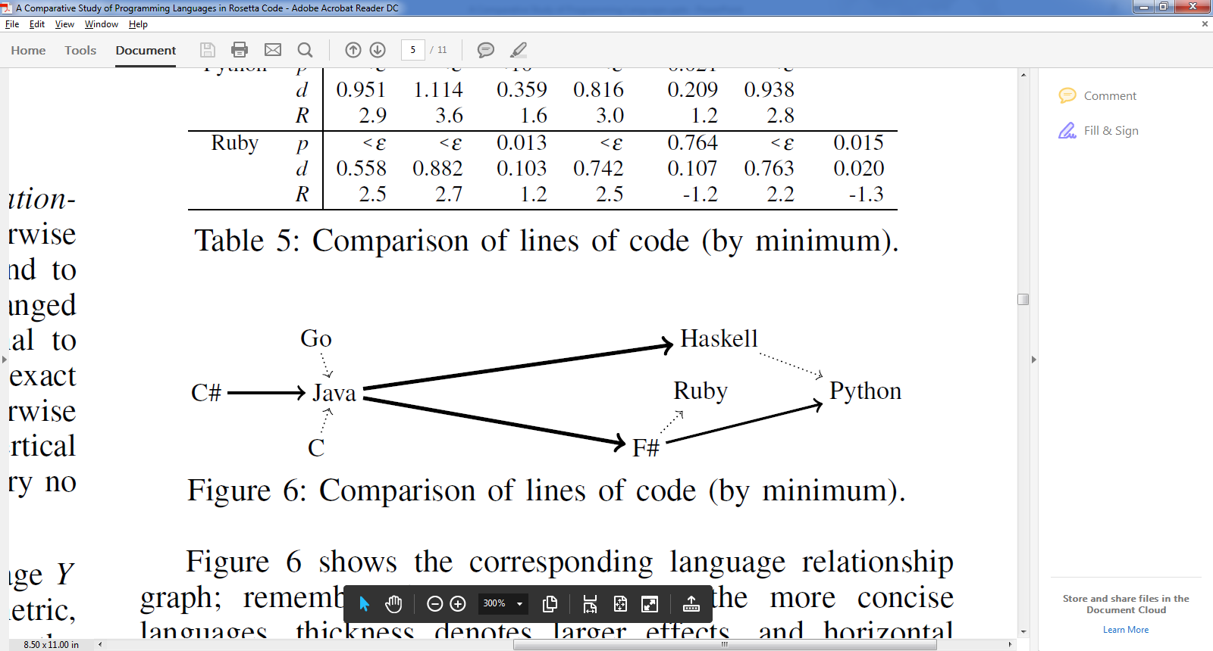
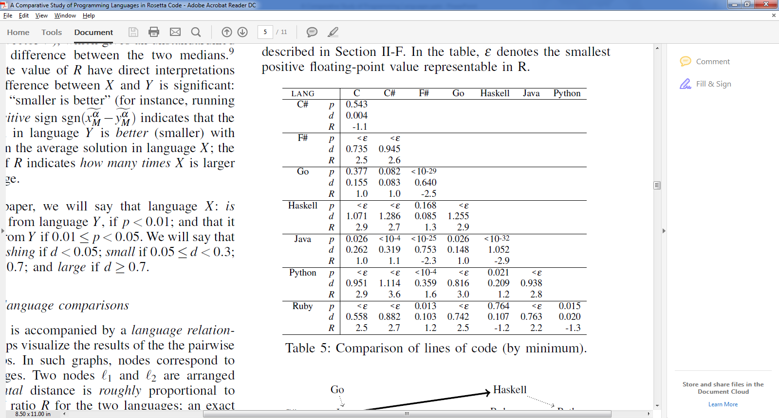
Results – RQ1 (Conciseness / Lines of code)

Slide 42
Conciseness (Lines of code)
Languages divided into two groups:
Group 1: functional and scripting – more concise
Group 2: OO and procedural – longer code
Major differences. i.e. Java 2.2-2.9 longer than Group 1.
Within the groups – no major difference.
Winner (by small amount): Python

Slide 43
Results – RQ1 (Conciseness / Lines of code)

Slide 44
Size Of Executable
RQ2 : Which programming language compile into smaller executables ?
Only those compiled successfully.
Languages are divided by whether they:
Compile into byte-code
Compile into native code
Ruby language – excluded, has no executable (interpreted).

Slide 45
Why is it important?
Executable is saved on HD, transported on network.
Executable (at least parts of it) is loaded into memory. (more at RQ4)
May turn irrelevant as years go by: HD sizes and speed increase (SSD).
Embedded systems.

Slide 46
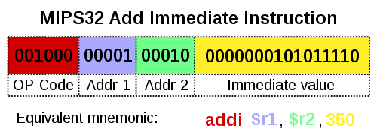
Native code
Code that is compiled to run with a particular processor (such as an Intel x86-class processor) and its set of instructions.
Programs compiled into native code:
C, C++, Go, Haskell

Slide 47
Byte-code
An intermediate instruction set, to which source code is compiled.
Then, Byte code can be either :
Interpreted by interpreter/Virtual machine.
Compiled to native code on demand (JIT compilation).
Highly portable.
Programs compiled into byte code:
Java, Python, C#, F#

Slide 48
Size Of Executable
RQ2 : Which programming language compile into smaller executables ?
Byte-code ? (Java, Python, C#, F#)
Native code ? (C, Go, Haskell)

Slide 49
Static vs. Dynamic linkage
If static libraries are called, the linker will copy all the modules referenced by the program directly into the executable.
Dynamic Linking Allows a process to add, remove, replace or relocate object modules during its execution.

Slide 50
Static vs. Dynamic linkage
…

Slide 51

Any guess ?
Gambling:
Which paradigms are better/worse?
Big Winner? (specific language)
Big Loser?
Ratio

Slide 52
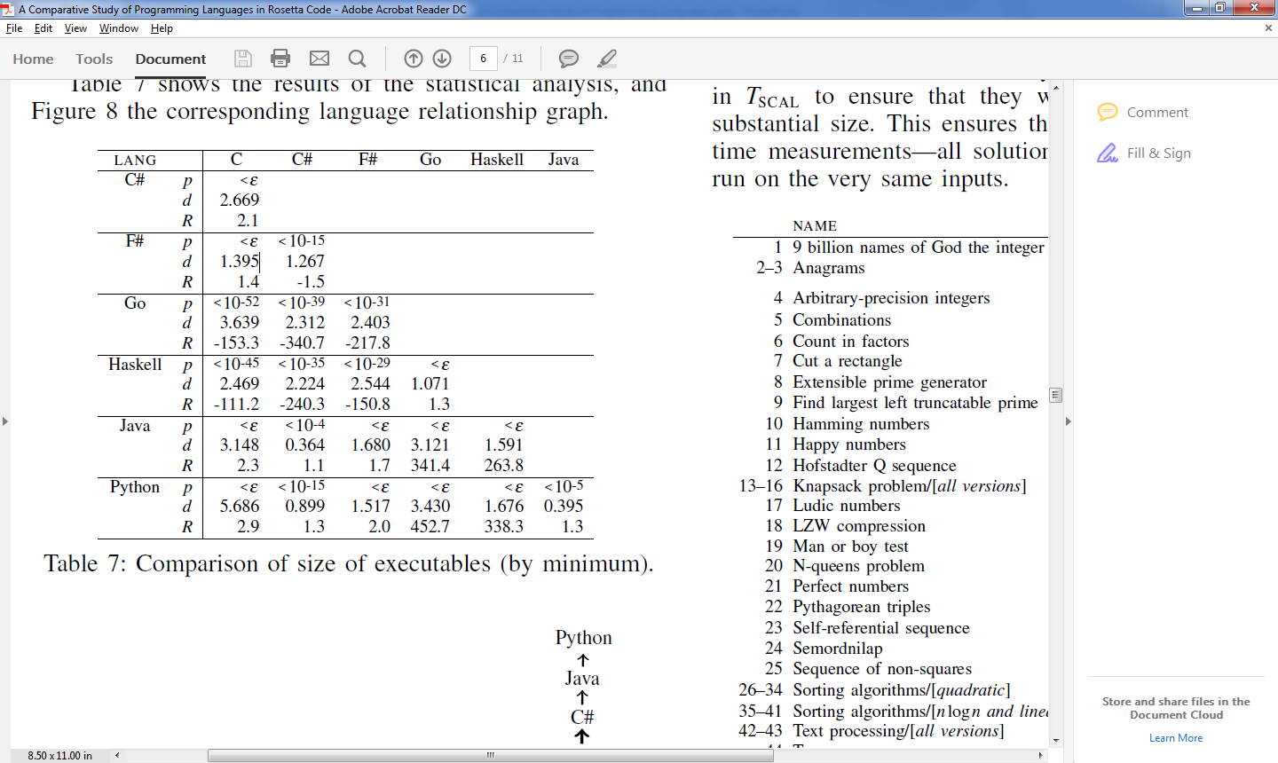
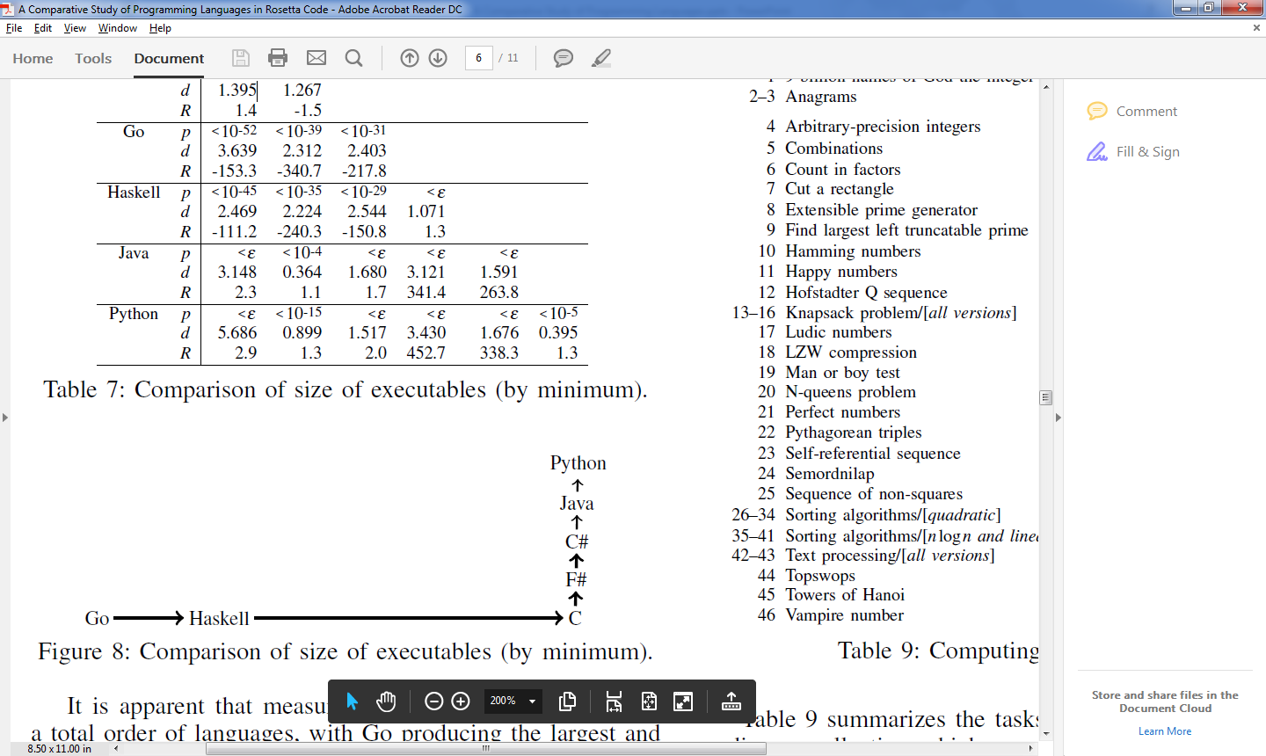
Results – RQ2 (Size of executable)

Slide 53
Size of Executable
Three consecutive groups:
Group 1: Native, Large executables (Go, Haskell)
Group 2: Native, Small executable (C)
Group 3: Bytecode, Small executable (F#, C#, Java, Python)
Winner (by small amount): Python
Losers: Go, Haskell
Ratio: Big, i.e. Java program 263 times smaller than Haskell !

Slide 54
Size of Executable
Languages that compile to byte code – are significantly smaller.
Languages that prefer Static linking produce much larger executables.

Slide 55
Running Time
RQ3 : Which programming languages have better running-time performance ?
Measure running time.
Small set of “Scalability tasks” – tasks that their input can be scaled up to create computing-intensive workload.
Exclude programs with errors and timeouts (over 3 mins.)

Slide 56
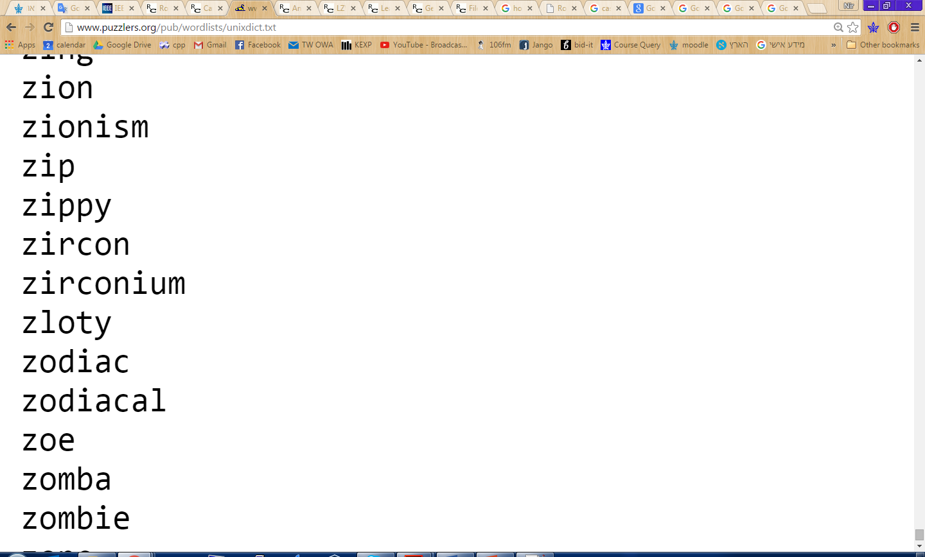
Running Time
Example: Anagrams
Anagram = two words that have the same letters in different order. i.e. veil, levi
Task: on the dictionary in unixdict.txt, find the longest sets of anagrams (sets that contain the most words).

Slide 57
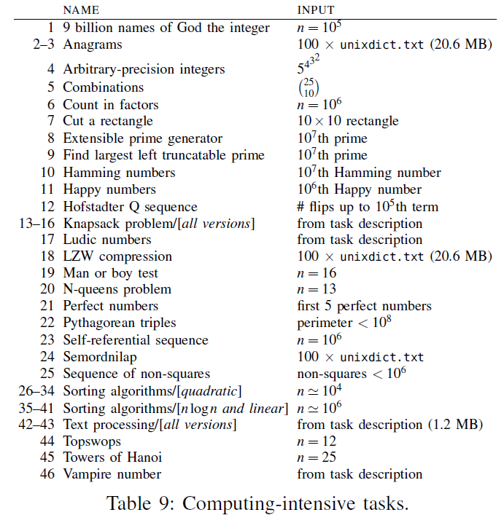
“Scalability tasks”

Slide 58
Running Time
“Scalability tasks”:
Text-processing tasks (Anagrams, Semordnilap).
Combinatorial puzzles (N-Queens problem, Towers of Hanoi).
NP-Complete problems (Knapsack).
Sorting algorithms.
All programs ran on very same inputs.
Minimize effect of I/O.

Slide 59
Running Time - Why it is important?
Well, duh…
However:
In real-time systems it is critical.
Systems with performance needs – large inputs (i.e. web traffic).
On “information”/”everyday“ type applications – maybe less important?
“Most applications do not actually need better performance than Python offers”¹

Slide 60
What might affect running time?
Object oriented world
Constructors, Destructors.
Virtual tables.
Heap management, Garbage collection.
Transitions into machine code.

Slide 61
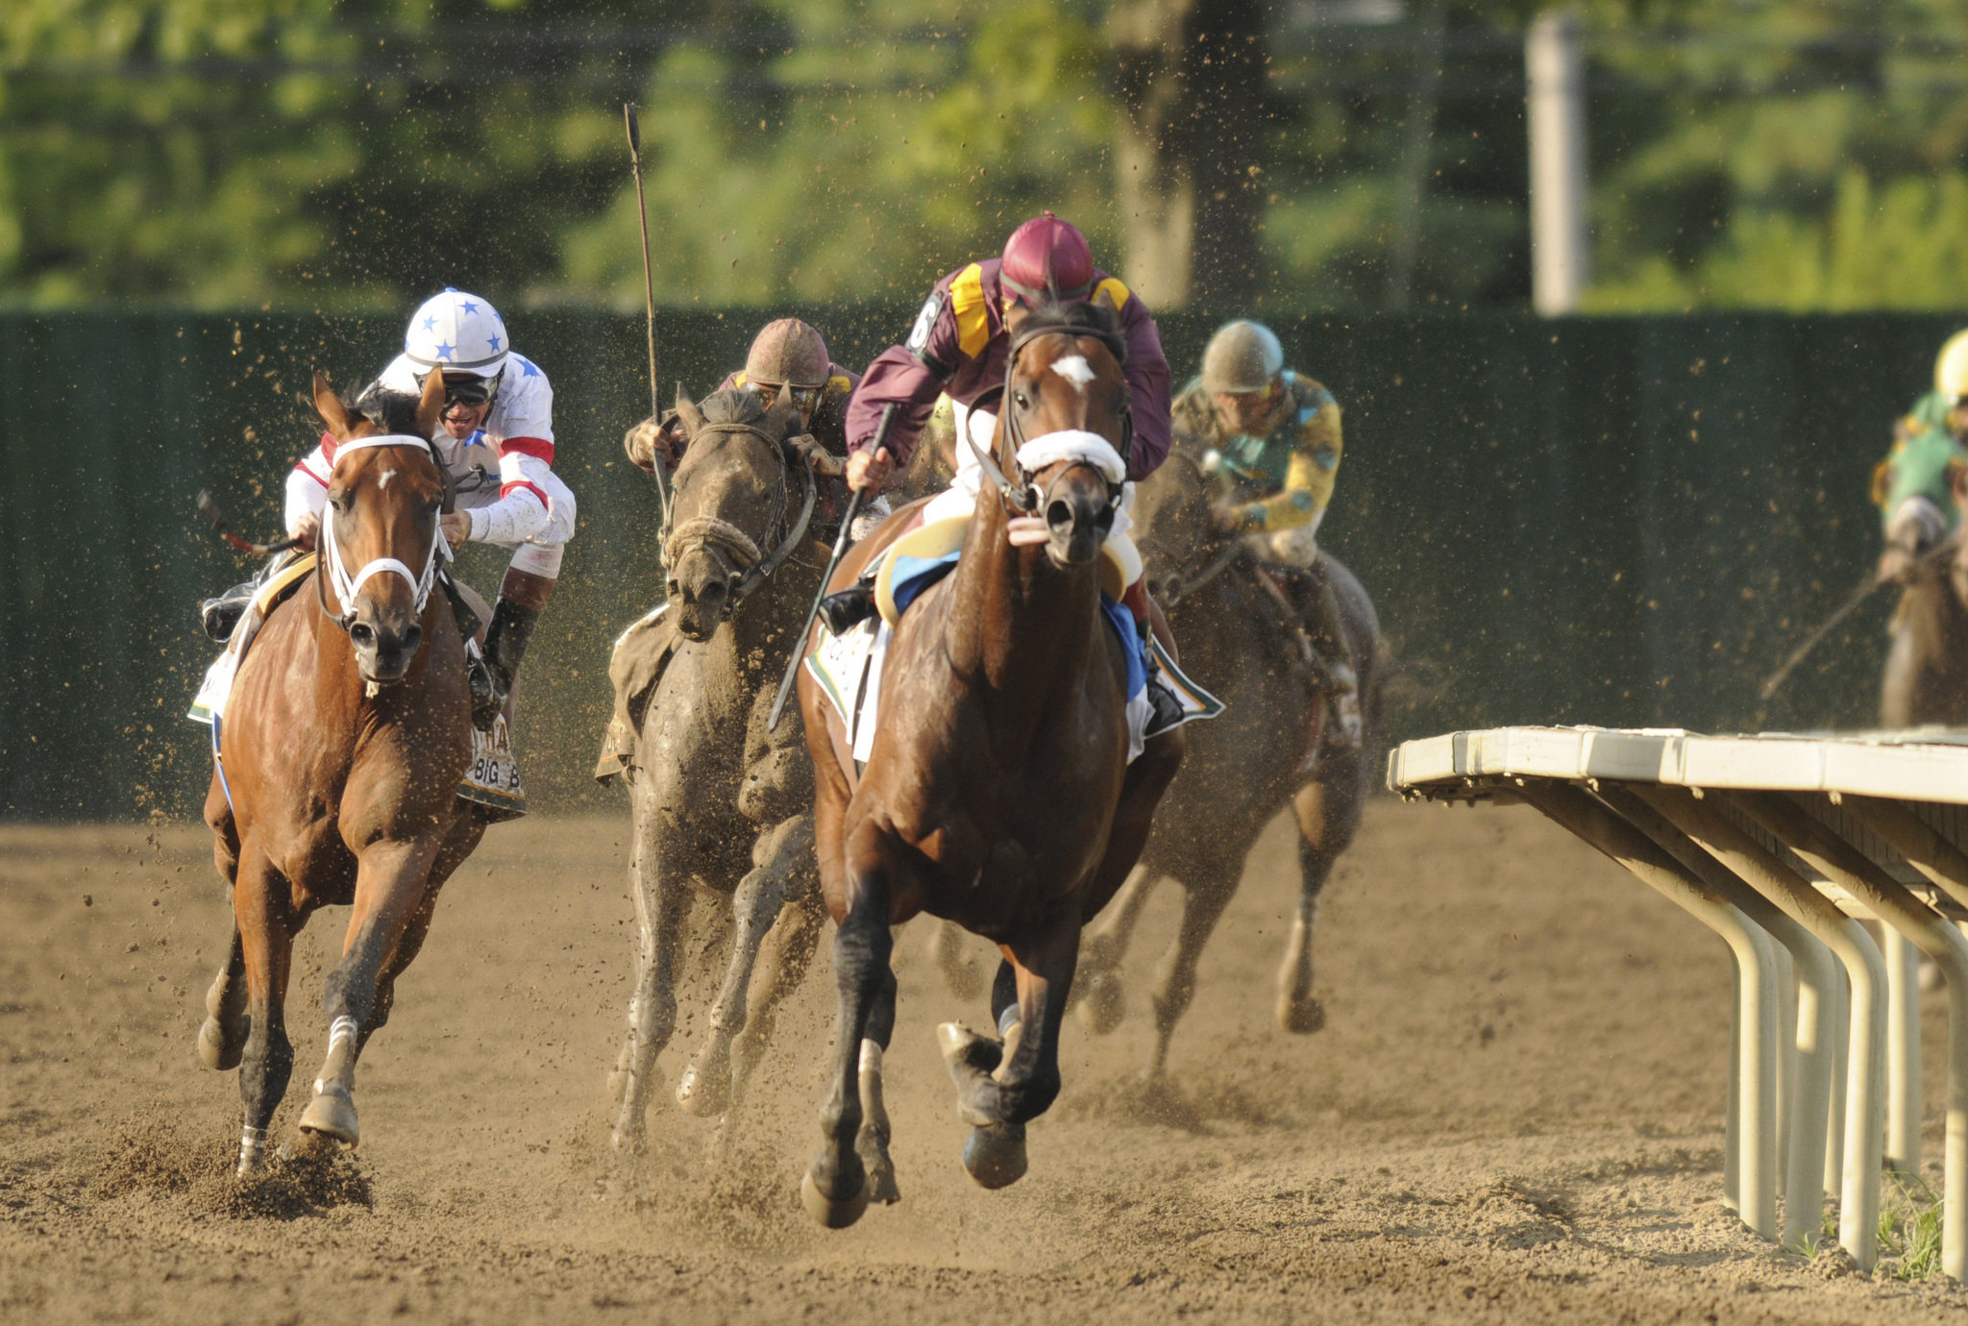
Any guess ?
Gambling:
Which paradigms are better/worse?
Big Winner? (specific language)
Big Loser?
Ratio

Slide 62
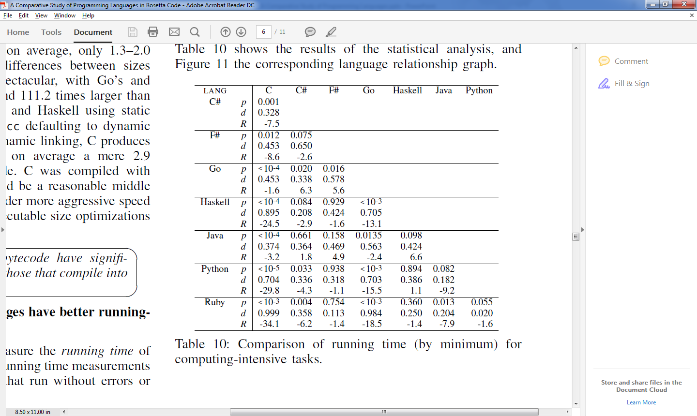
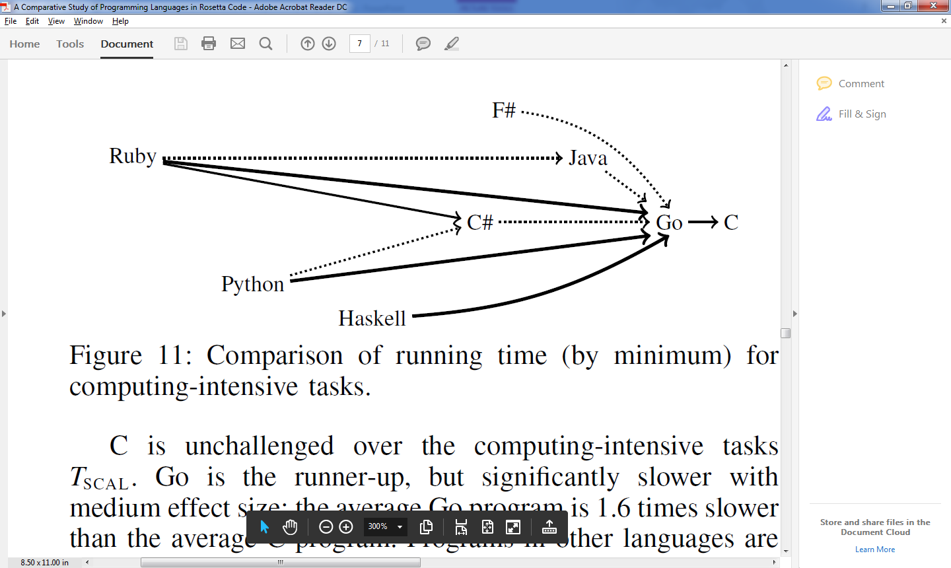
Results – RQ3 (Running Time: Computing-intensive tasks)

Slide 63
Running Time
Procedural languages win. Scripting/Functional languages lose.
Big winner: C, Runner-up: Go (1.6 slower than C).
Ratio: Big – Haskell and Python 15.5-13.1 slower than Go.

Slide 64
Running Time – Performance tasks
Tasks that can be measured for performance, but don’t scale naturally to large instances.
Checksum algorithms (Credit Card Validation).
String manipulations (reversing words inside a string).
System-library access (Securing a temp file).

Slide 65
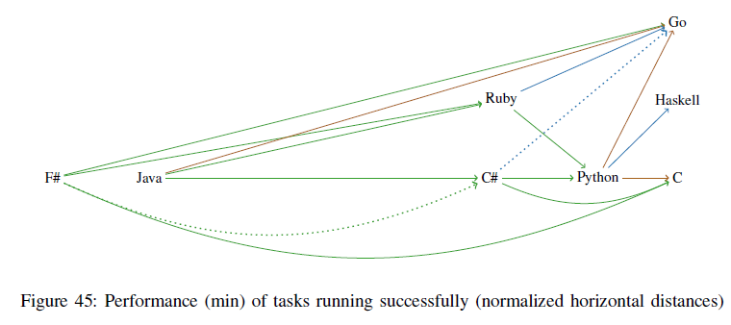
Results – RQ3 (Running Time: “Normal” performance tasks)

Slide 66
Running Time – Performance tasks
Results are much more varied.
The ratios are smaller: C# on Java: 2.5 faster, Python on Java: 6.6 faster.
Winners: procedural and Haskell, but all others are equally competitive.
Results show a difference between “everyday” and “computing intensive”.

Slide 67
Memory Usage
RQ4 : Which programming languages use memory more efficiently ?
Measured maximum RAM size consumed by the program.
Measured on the “Scalability tasks”.
Those who ran without errors or timeouts.
Includes memory of “runtime environment” (i.e. JVM)

Slide 68
Mem. Usage - Why it is important?
As in “Size of executable” discussion, does the value of RAM decease ?
Still:
Application competing with others (mobile).
On performance driven systems – Exceeding max RAM affects performance badly (swap to disk).
Redundant RAM (excluding leaks) may reflect wrong usage of data structures?

Slide 69
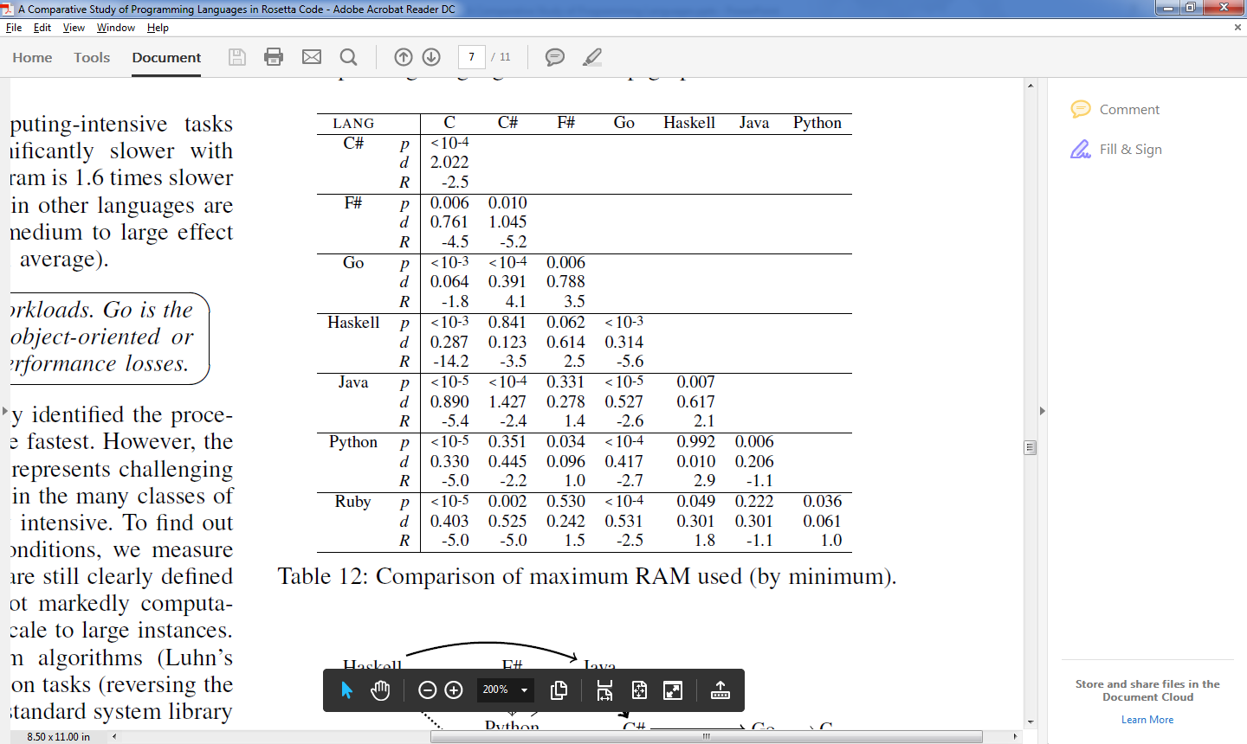
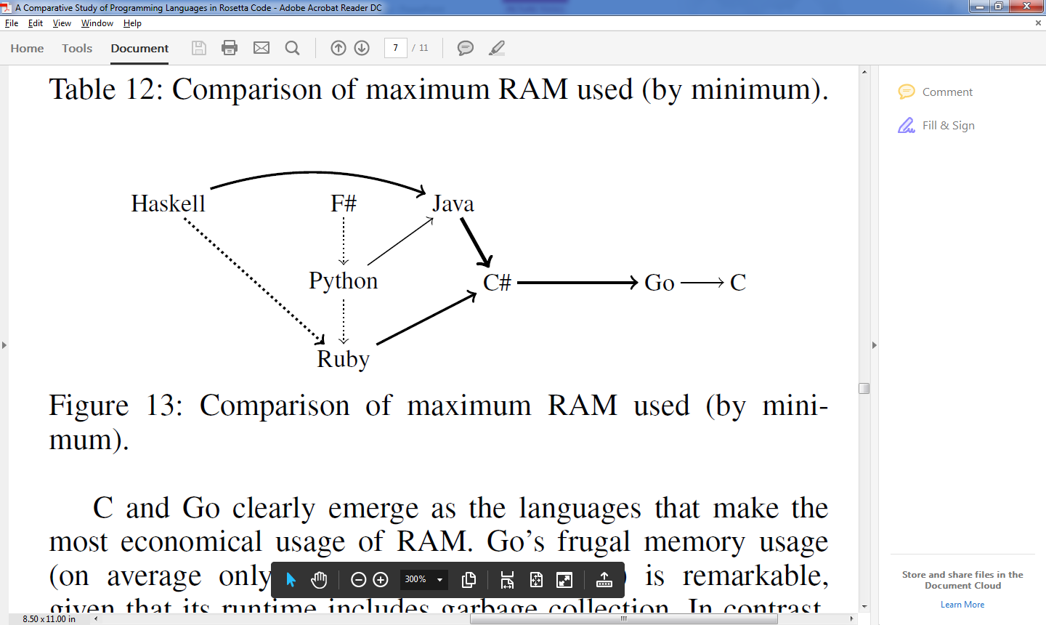
Results – RQ4 (Max Memory usage)

Slide 70
Safety / failure-proneness
RQ5 : Which programming languages are less failure-prone?
…

Slide 71


Slide 72


Slide 73
Further discussion
Capability and behavior differences between programmers – Proved more important than languages. ¹

Slide 74
Bibliography

Slide 75

Lists
Accessing list elements

